Slide 1
speed: An R package for Spatially Efficient Experimental Designs
Sam Rogers, Wasin Pipattungsakul, Julian Taylor

Slide 2
Outline
Background
Motivation & Limitations
Overview of the package
Key features
Examples and comparisons
Custom Objective Function example
Future plans
Summary

Slide 3


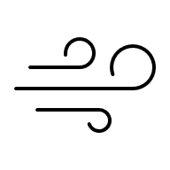
Background
Agricultural field trials often exhibit spatial trends
Slopes, environmental factors (e.g. wind, shade, …), system setup
Proper experimental design is vital
Limited options to account for spatial trends
Design for the trends – spatial optimisation

Slide 4
Background
A | B | C | D | E
A | B | C | D | E
A | B | C | D | E
A | B | C | D | E
D | A | E | E | E
D | B | A | D | B
C | B | C | A | C
A | B | C | E | D
E | B | A | D | C
C | A | D | B | E
D | C | E | A | B
A | E | B | C | D
Systematic
Fully random
Restricted randomisation

Slide 5
Motivation
Many design packages available
AlgDesign, dae, agricolae, GenStat, SAS, …
More recently: biometryassist, FielDHub, skpr
Very few handle spatial optimisation of designs
DiGGer
odw

Slide 6
Limitations
Current tools are difficult to access, and lacking in some key areas
odw
Lack of documentation
No reproducibility (seed)
Not widely accessible from a repository
DiGGer
Complex documentation
Difficult system dependencies on Linux
Some complex setup required for designs
Not widely accessible from a repository

Slide 7
Introducing R package speed
Spatially Efficient Experimental Design
User-friendly documentation. Easy for beginners, powerful for experts
Capable of producing a wide range of designs: RCB, split-plot, strip-plot, p-rep, incomplete blocking, 2D blocking, Multi-Environment Trials, factorial*, …
Customisable objective function
Maintains reproducibility with controllable random seed
Optimisation parameters that can be adjusted
Available at https://github.com/biometryhub/speed
*coming soon

Slide 8
Our Approach – Initial Research
We explored a model-free approach with Piepho’s paper¹. Piepho swapped treatments in a design with certain rules and 2 metrics, evenness of distribution (ED) and neighbour balance (NB).
ED: the spread of the same treatments represented by minimum spanning tree (higher is better)
NB: count of the same adjacent treatment pairs (lower is better)
¹Piepho, H., Michel, V., & Williams, E. (2018). Neighbor balance and evenness of distribution of treatment replications in row-column designs. Biometrical Journal, 60(6), 1172-1189.

Slide 9
Our Approach – Simulated Annealing
After consulting with ChatGPT and Claude, we ended up with simulated annealing algorithm with 2 metrics (objectives).
Adjacency score: a count of adjacent pairs of the same treatment (lower is better)
Balance score: total variance of the count of each treatment in spatial factors, e.g., row, column, block (lower is better)
A | C | C | D | E
: adj = 1, bal = var(1, 0, 2, 1, 1) = 0.5
A | B | C | D | E
: adj = 0, bal = var(1, 1, 1, 1, 1) = 0

Slide 10
Our Approach – Simulated Annealing
In each iteration,
Generate a neighbour of the current design by swapping items 1 or more time.
Calculate the score of the generated design from an objective function.
Accept the new design if the score is better than the current one or by chance which decreases over iteration.
A | B | C | D | E
A | B | C | D | E
A | B | C | D | E
A | B | C | D | E
A | B | C | D | E
C | B | C | D | E
A | B | A | D | E
A | B | C | D | E

Slide 11
Our Approach – Simulated Annealing
In each iteration,
Generate a neighbour of the current design by swapping items 1 or more time.
Calculate the score of the generated design from an objective function.
Accept the new design if the score is better than the current one or by chance which decreases over iteration.
A | B | C | D | E
C | B | C | D | E
A | B | A | D | E
A | B | C | D | E
func( ) = 23

Slide 12
Our Approach – Simulated Annealing
In each iteration,
Generate a neighbour of the current design by swapping items 1 or more time.
Calculate the score of the generated design from an objective function.
Accept the new design if the score is better than the current one or by chance which decreases over iteration.
A | B | C | D | E
C | B | C | D | E
A | B | A | D | E
A | B | C | D | E
23 < 28:

Slide 13
Key Feature Summary
Feature | speed | odw | DiGGer
Public Availability | ✔ | ✘ | ✘
Open source | ✔ | ✘ | ✘
Community contributions | ✔ | ✘ | ✘
User-friendly documentation | ✔ | ✘ | ✘
Reproducibility | ✔ | ✘ | ✔
Custom design objectives | ✔ | ? | ✘
Fast, Model-free metrics | ✔ | ✘ | ?
Search algorithm | Simulated annealing | Tabu search | Reactive Tabu Search
Algorithm language | R | C/C++ | C/C++

Slide 14
Using speed - examples
speed(
data,
swap,
swap_within = "1",
spatial_factors = ~ row + col,
grid_factors = = list(dim1 = "row", dim2 = "col")
iterations = 10000,
early_stop_iterations = 2000,
obj_function = objective_function,
quiet = FALSE,
seed = NULL,
...
)
data: a design dataframe
swap: a factor (treatment) to be swapped with in swap_within
swap_within: a factor constraining a region of the swaps
spatial_factors: factors to be spatially optimised while swapping
grid_factors: factors to construct a matrix for adjacency calculations
iterations: maximum number of iterations for the algorithm
early_stop_iterations: number of iterations allowed without improvement
obj_function: objective function for the algorithm after each iteration

Slide 15
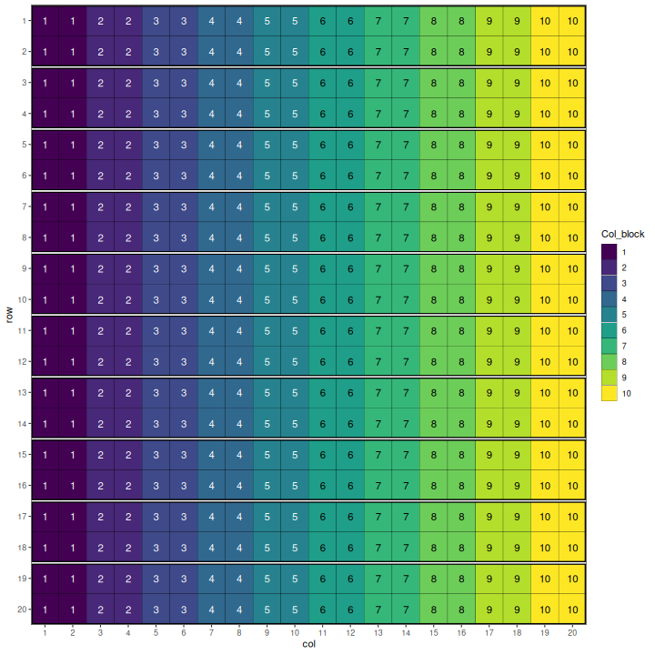
Examples – 2D Blocking
20 rows x 20 columns
40 treatments
10 replications
10 2x20 row blocks
10 20x2 col blocks

Slide 16
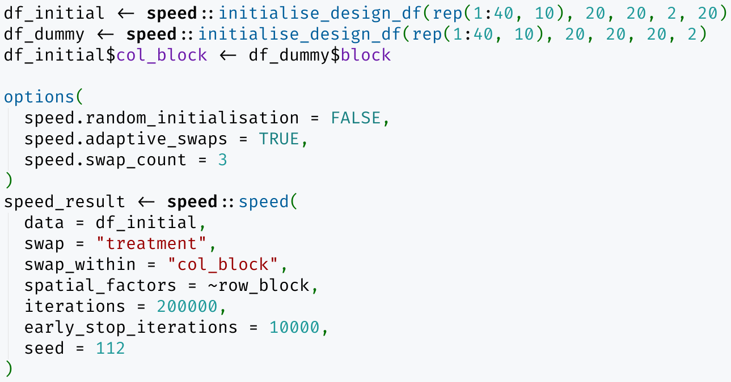
Examples – 2D Blocking
20 rows x 20 columns
40 treatments
10 replications
10 2x20 row blocks
10 20x2 col blocks

Slide 17
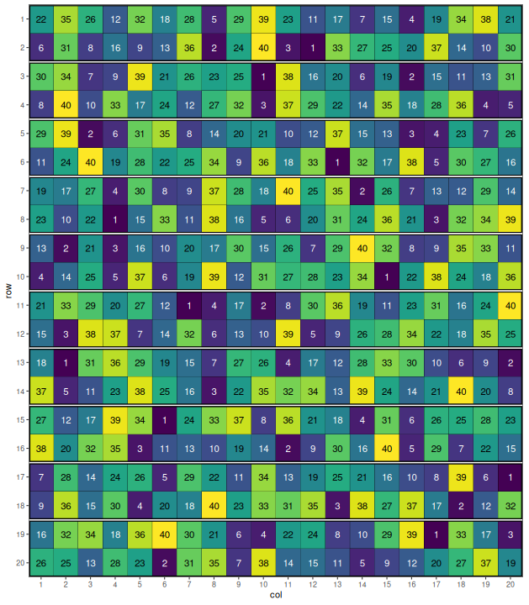
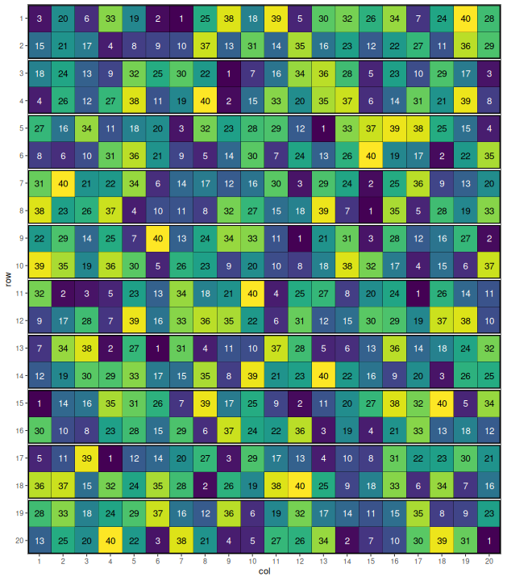
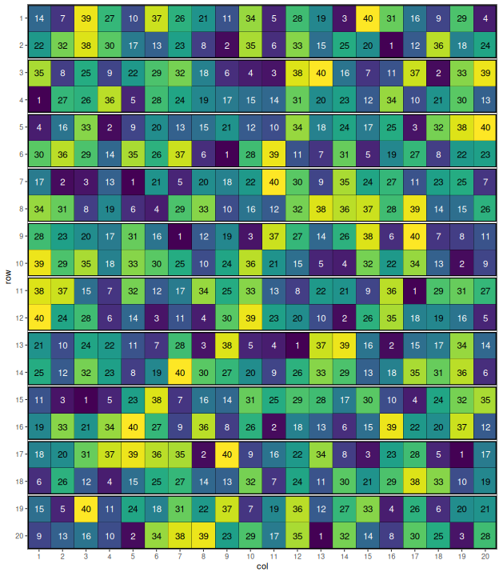
Examples – 2D Blocking
DiGGer
odw
speed

Slide 18
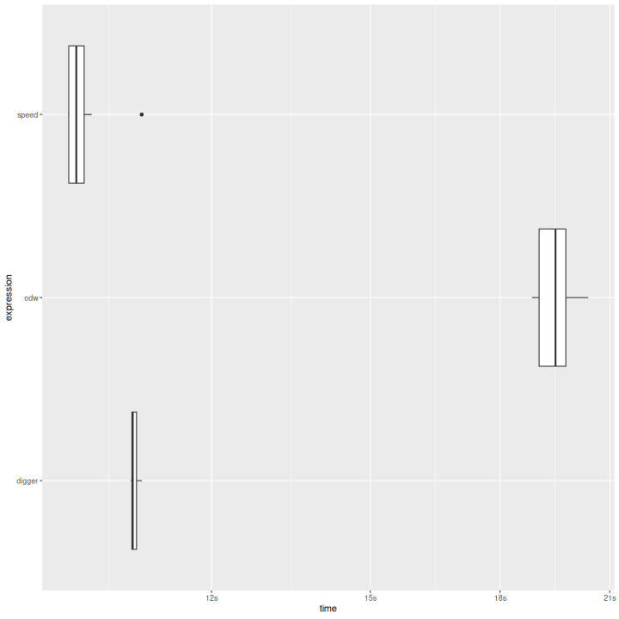
Examples – 2D Blocking
20 rows x 20 columns
40 treatments
10 replications
10 2x20 row blocks
10 20x2 col blocks
speed
odw
DiGGer
12 15 18 21
Time (s)

Slide 19
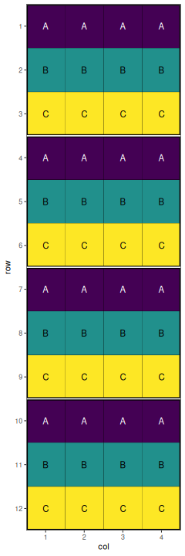
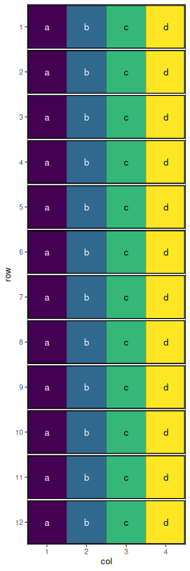
Examples – Split Plot
Blocks
Wholeplots
12 rows x 4 columns
3 wholeplot treatments
4 wholeplot replications
4 3x4 blocks
4 subplot treatments
12 subplot replications
12 1x4 wholeplots

Slide 20
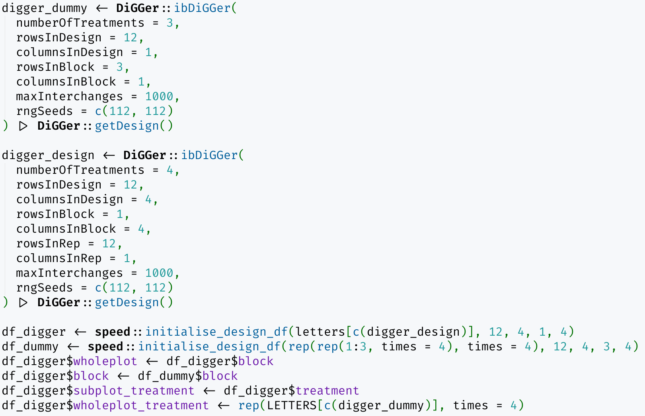
Examples – Split Plot: DiGGer
Optimise
wholeplot
treatments
Optimise
subplot
treatments
Stitch
together

Slide 21
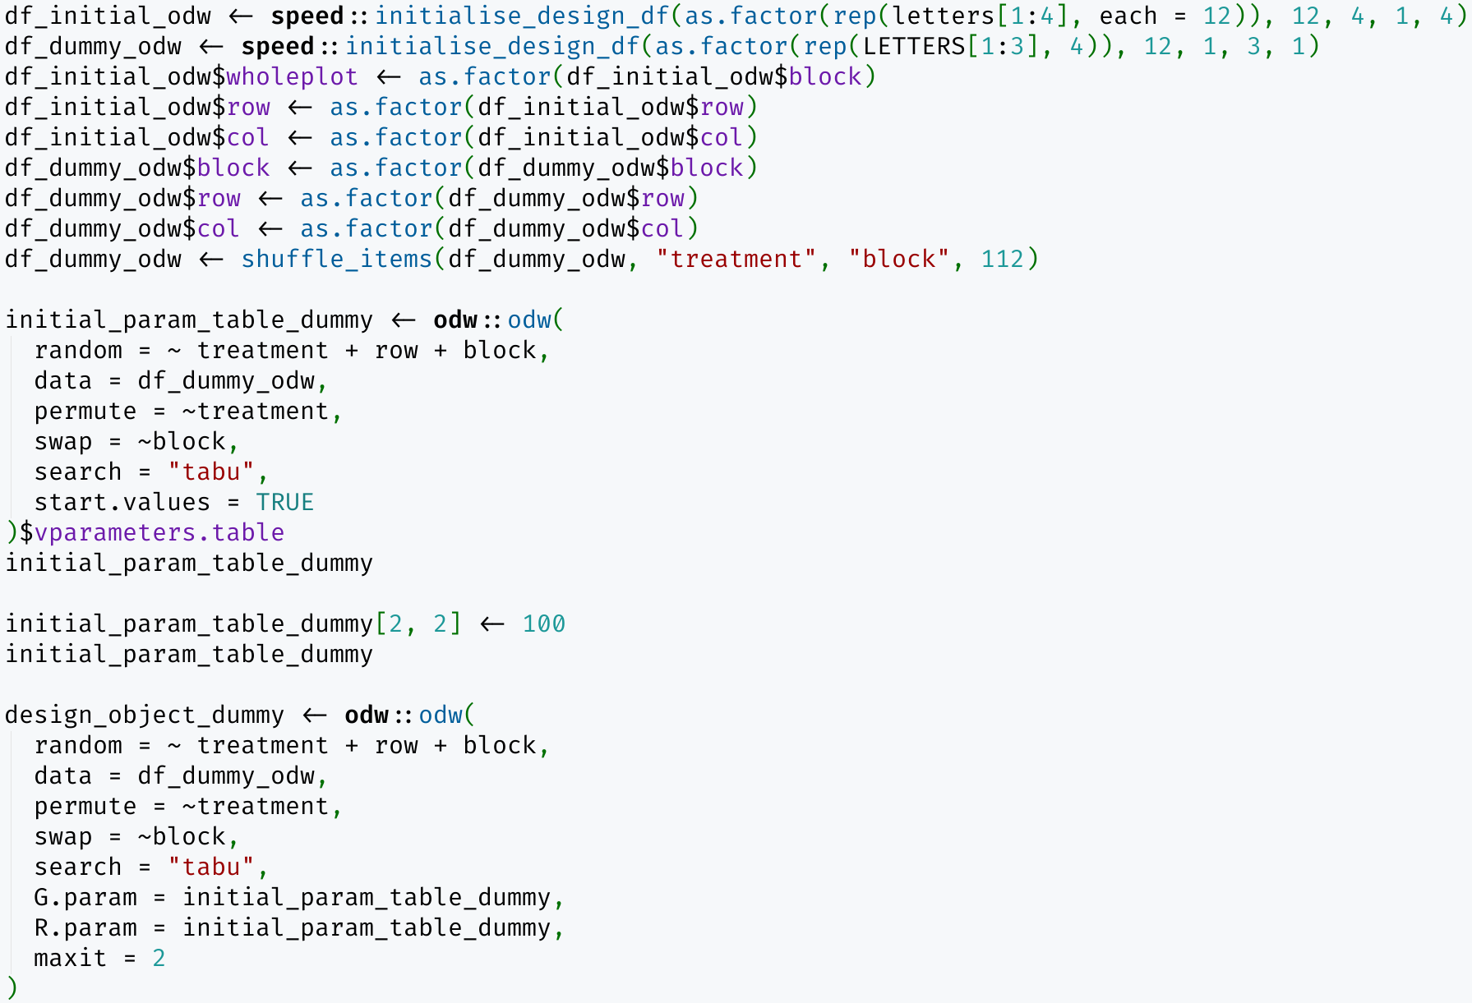
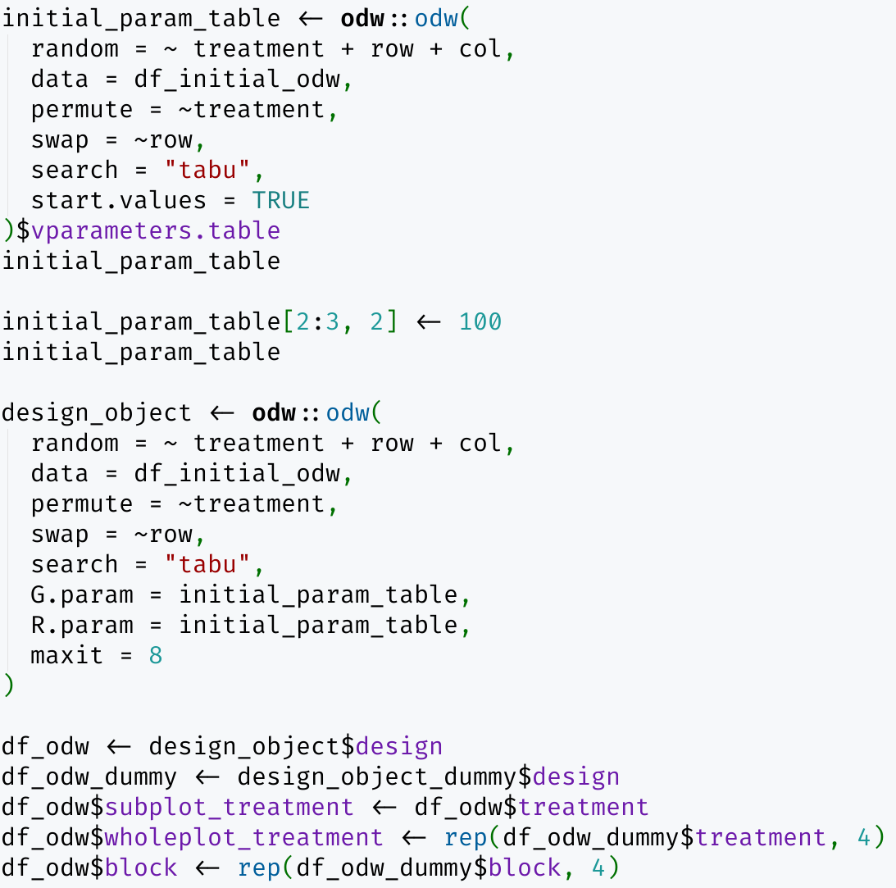
Examples – Split Plot: odw
Initialise dataframes
Optimise
subplot
treatments
Optimise
wholeplot
treatments
Stitch
together

Slide 22
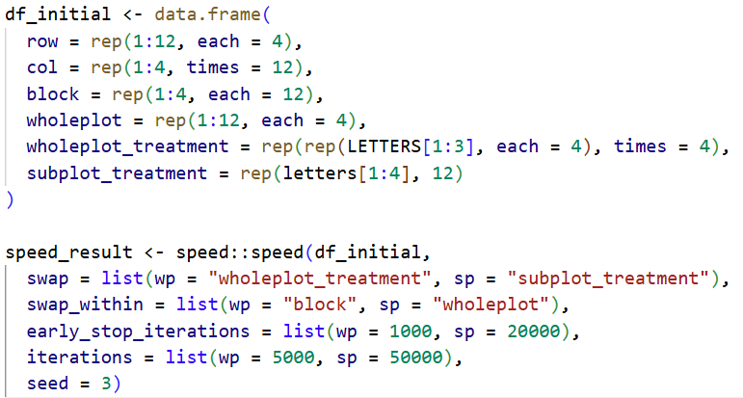
Examples – Split Plot: speed
Initialise a dataframe
Optimise both whole plot and subplot treatments in one go

Slide 23
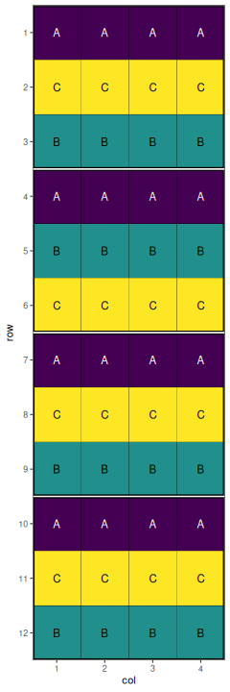
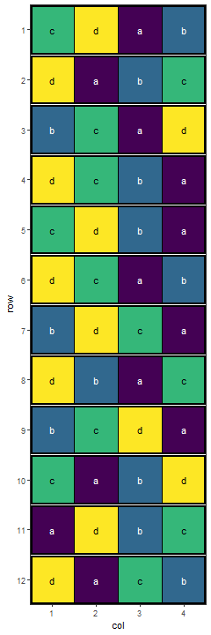
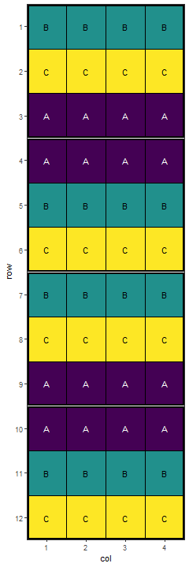
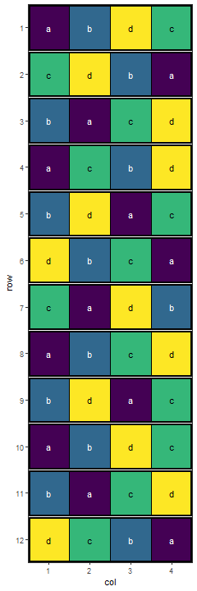
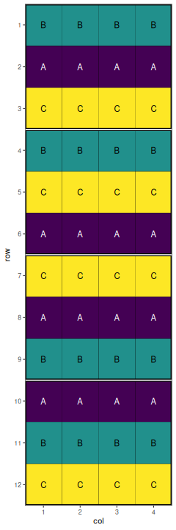
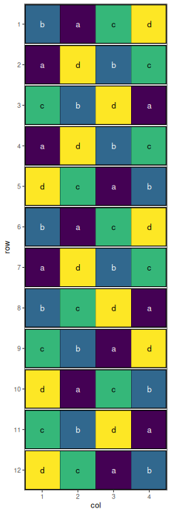
Examples – Split Plot
DiGGer
odw
speed

Slide 24
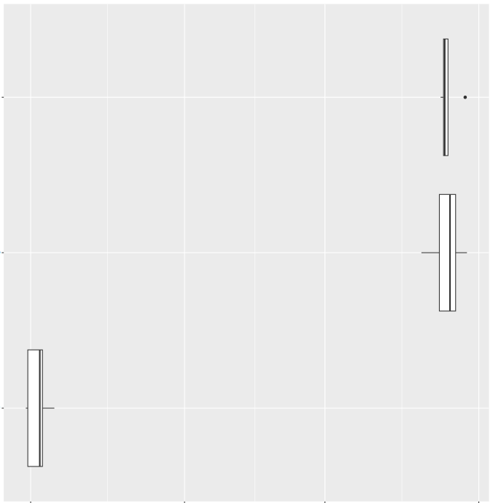
Examples – Split Plot
12 rows x 4 columns
3 wholeplot treatments
4 wholeplot replications
4 3x4 blocks
4 subplot treatments
12 subplot replications
12 1x4 wholeplots
speed
odw
DiGGer
30 100 300 1000
Time (ms)

Slide 25
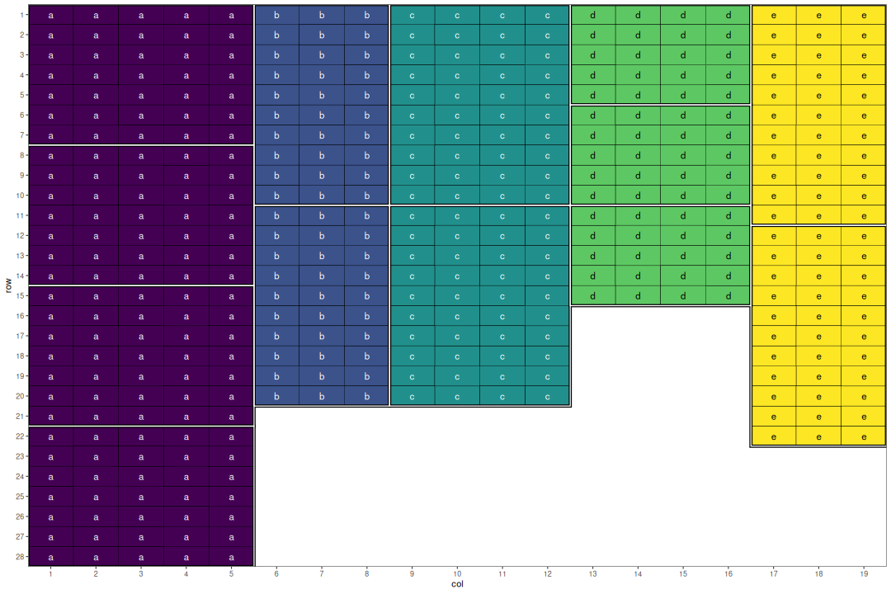
Examples – Multi Site
5 sites
28×5
20×3
20×4
15×4
22×3
57 treatments, 7-8 reps

Slide 26
Examples – Multi Site
speed
Initialise a
dataframe
all_treatments <- c(rep(1:50, 7), rep(51:57, 8))
designs <- list(
a = list(nrows = 28, ncols = 5, block_nrows = 7, block_ncols = 5),
b = list(nrows = 20, ncols = 3, block_nrows = 10, block_ncols = 3),
c = list(nrows = 20, ncols = 4, block_nrows = 10, block_ncols = 4),
d = list(nrows = 15, ncols = 4, block_nrows = 5, block_ncols = 4),
e = list(nrows = 22, ncols = 3, block_nrows = 11, block_ncols = 3)
)
df_initial <- speed::initialise_design_df(items = all_treatments, designs = designs)
df_initial$site_col <- paste(df_initial$site, df_initial$col, sep = "_")
df_initial$site_block <- paste(df_initial$site, df_initial$block, sep = "_")
optimize <- list(
connectivity = list(spatial_factors = ~site),
balance = list(swap_within = "site", spatial_factors = ~ site_col + site_block)
)
speed_design <- speed::speed(
data = df_initial,
swap = "treatment",
early_stop_iterations = 5000,
optimise = optimize,
seed = 112
)
Sequentially optimise cross- and
within- site allocations in one call

Slide 27
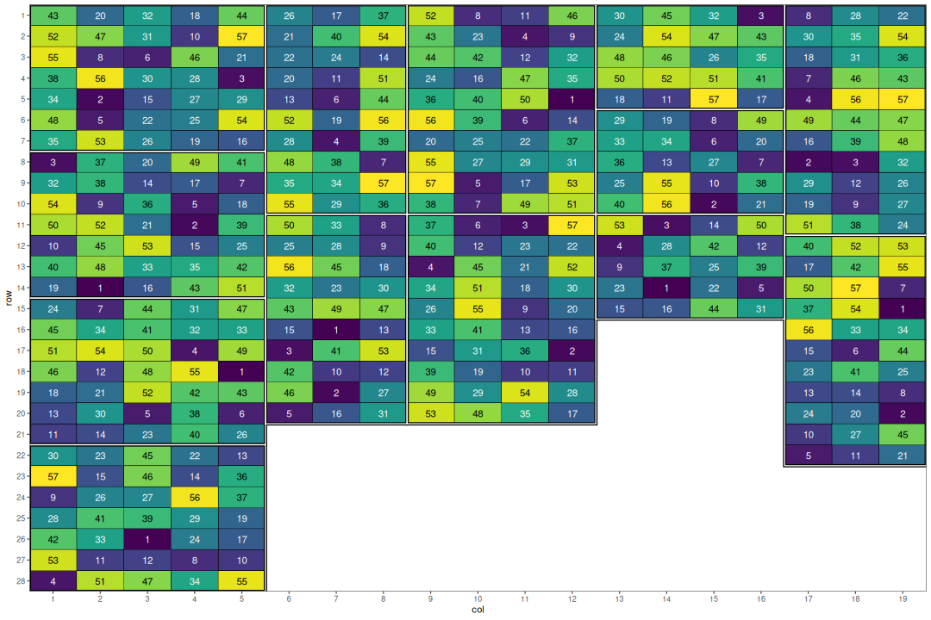
Examples – Multi Site
a b c d e

Slide 28
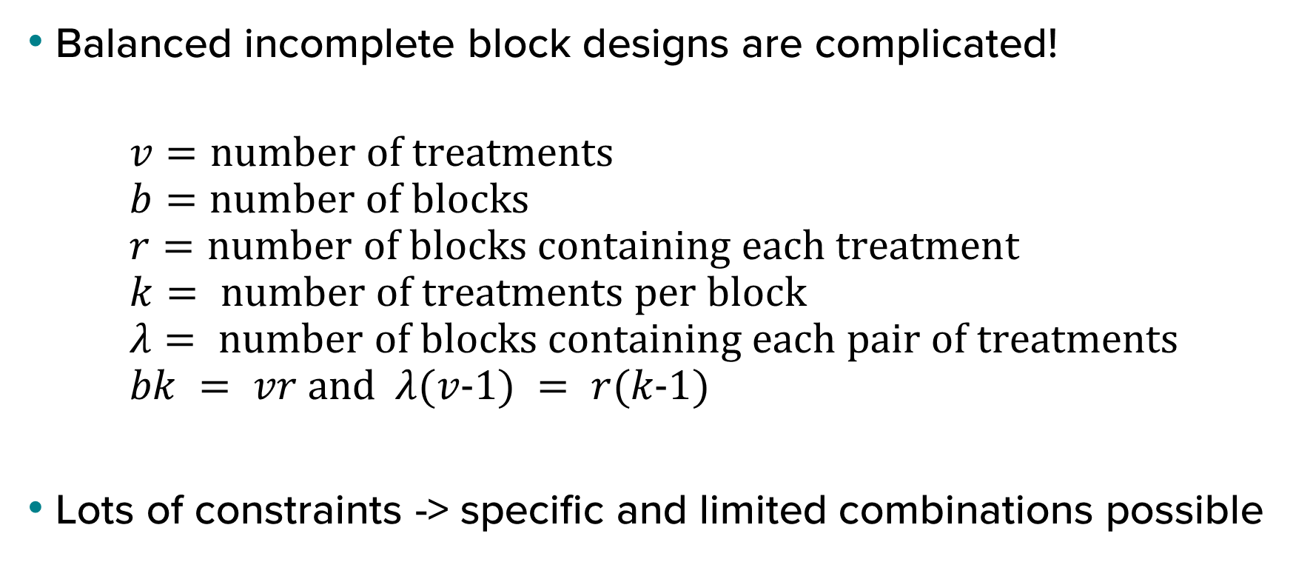
Examples – BIBD
Balanced incomplete block designs are complicated!
$$v=\text{number} \text{of} \text{treatments} \\ b=\text{number} \text{of} \text{blocks} \\ r=\text{number} \text{of} \text{blocks} \text{containing} \text{each} \text{treatment} \\ k= \text{number} \text{of} \text{treatments} \text{per} \text{block} \\ λ= \text{number} \text{of} \text{blocks} \text{containing} \text{each} \text{pair} \text{of} \text{treatments} \\ bk = vr \text{and} λ(v−1) = r(k−1)$$
Lots of constraints -> specific and limited combinations possible

Slide 29
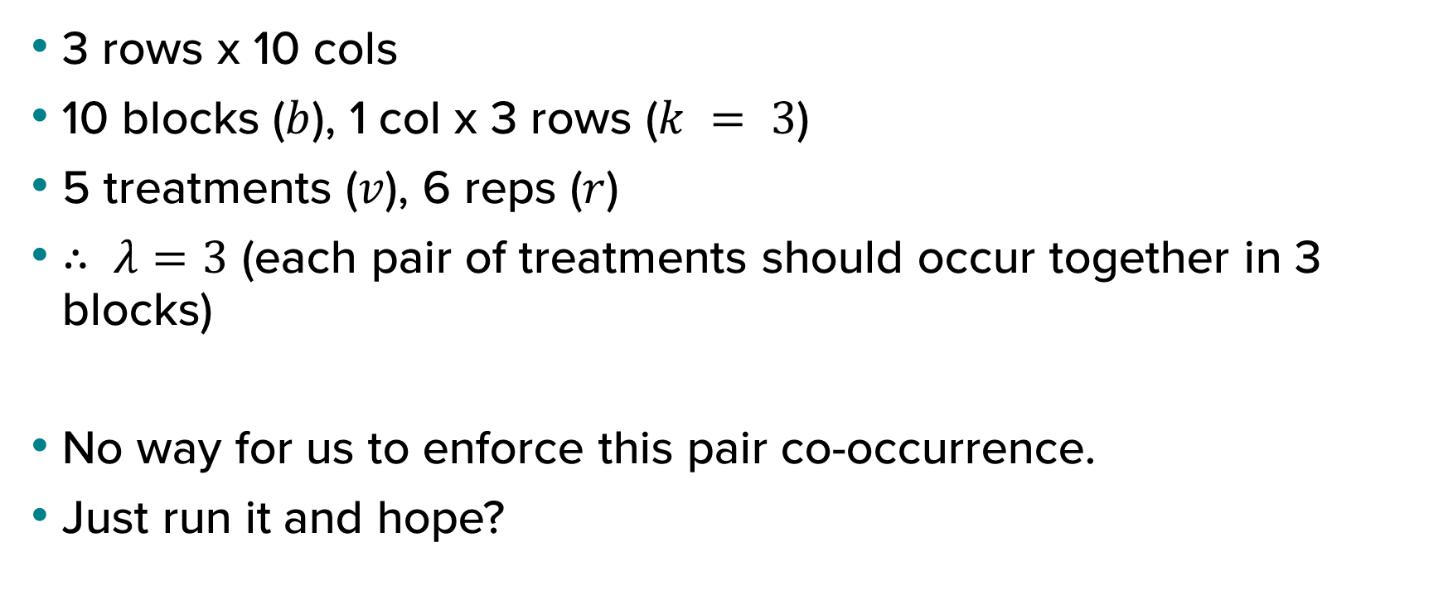
Examples – BIBD
3 rows x 10 cols
10 blocks ($b$), 1 col x 3 rows ($k = 3$)
5 treatments ($v$), 6 reps ($r$)
$∴ λ=3$ (each pair of treatments should occur together in 3 blocks)
No way for us to enforce this pair co-occurrence.
Just run it and hope?

Slide 30
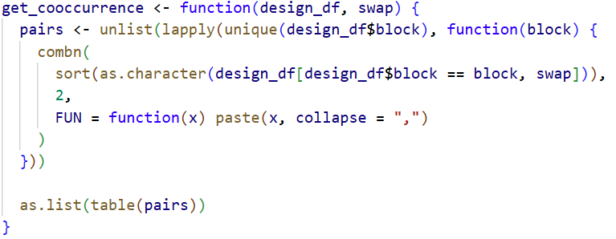
Custom objective function to the rescue!
Need a function to check co-occurrences

Slide 31
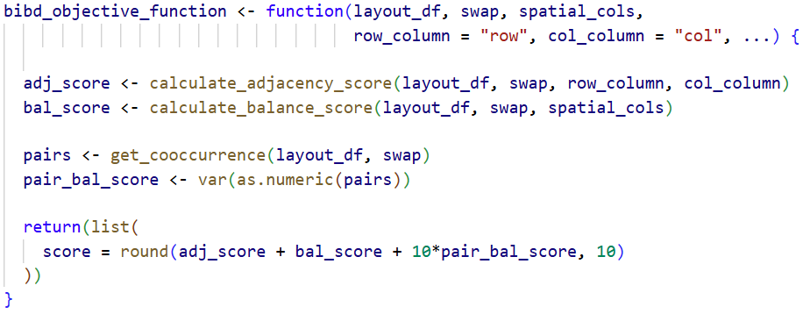
Custom Objective Function
Still optimising spatially
Calculate the pair balance
Weight the pair balance higher

Slide 32
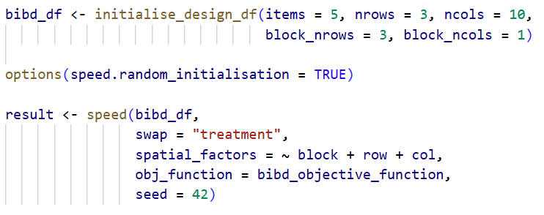
Custom Objective Function
Set up the data frame
Shuffle treatments before beginning
Balance between block, row and col
Pass in custom objective function

Slide 33
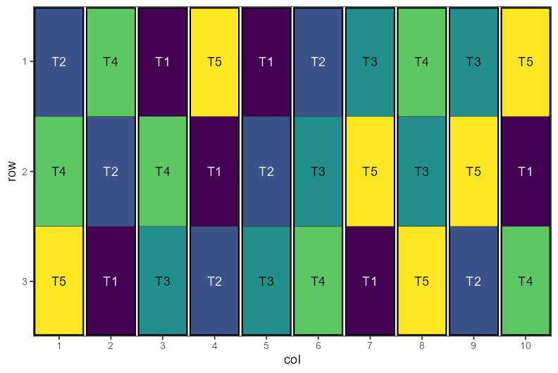
Balanced Incomplete Block Design

Slide 34
Future Plans
Support more complex design scenarios.
Factorial
Treatment relationships (e.g. genetic relationship matrix)
Continue adding to vignettes and examples
Enhance the helper function to build data frames for more complex designs.
Shiny app.
Computational time improvements.

Slide 35

Summary
speed can find spatial optimality for a range of designs including RCB, split-plot, p-rep, MET in one function call, with more coming soon™️.
Objective function can be customised.
Documentation is user friendly.
The package in under active development.
Please check it out at https://github.com/biometryhub/speed. We would love to fix bugs and implement new features.

Slide 36

Thank you Q&A

